Slide 1

No-te-it
CSIS-3175 – 002 Project Introduction to Mobile App Dev
Project Members
Nidhi (300378175)
Edison (300370372)

Slide 2
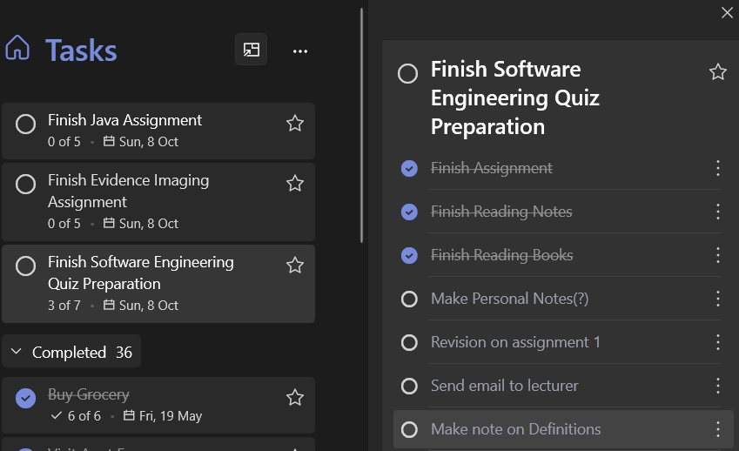
To-Do | Grocery List | Reminders | Saved lists
“To-do list but for studying”
Not just taking notes…
Targeting Students
From MIDTERM to GROCERY
Turn your smartphone into a workbook
Getting A(s)

Slide 3
Outcomes
A To-do | Note making APP that has…
To-Do checkbox List (N)
Saved list (E)
Exam prep list, Grocery list, Tour list, Credit Bill List
Categories (N)
Reminder System (E)
Share Function (E)

Slide 4
Tools to be used
Android Studio
Push notification APIs (Optional)
Multiplatform and Social media APIs

Slide 5
Additional features
Multimedia:
Keep any kind of multimedia,
Including images, audio, lecture notes, etc
Multi-User
Share notes across platforms
Collaborate with colleagues and teammates
Scalability
(Future Development) Platform to download saved list from past attendees

